Slide 1
Over view of proposed HL7 V2 genetics message
And some background on NLM forms Form builder and UCUM validator
June 8, 2016, Regenstrief Institute, Indianapolis.
Clem McDonald- Lister Hill Center for Biomedical Communication

Slide 2
Current state of the world based on request for new LOINC codes from LOINC test kit/instrument manufacturers and laboratories

Slide 3
Kinds of molecular genetic tests now in LOINC
LOINC gets lots of requests for but increasingly new tests are genetic
There are three kinds:
1) Those that report the presence/absence or quantity of a specific genetic finding :
53761-3 JAK2 gene p.V617F mutant/​Normal reported as %
49631-5 ATN1 gene allele 1.CAG repeats – reported as a number
24475-6 F2 gene c.20210G>A [Presence] – reported as presence or absence
58416-9 MLH1 gene methylation [Presence] – Reported as presence or absence

Slide 4
Kinds of molecular genetic tests in LOINC 2
2) Those that report upper level interpretation of many lower level genetic findings
Examples:
77354-9 Noninvasive colorectal cancer DNA and occult blood screening [Presence] in Stool ( Measures 12+ genes and occult blood – generates a logistic regression equation and report yes/no (High risk or not) –The Cologuard test
Five different maternal cell free plasma (non invasive) prenatal screening test report a variety of categorical or quantitative results inferred from the genetic testing
77354-9 Noninvasive colorectal cancer DNA and occult blood screening [Presence] in Stool
75601-5 Fetal 1p36 deletion risk [Likelihood] based on Plasma cell-free+WBC DNA by Dosage of chromosome-specific cfDNA [targetted] –reports a likelihood.
75982-9 Fetal Chromosome 18 triso my [Presence] based on Plasma cell-free DNA by Dosage of chromosome-specific cfDNA –reports aneuploidy, aneuploidy suspected, aneuploidy detected
77021-4 Fetal Y chromosome [Presence] based on Plasma cell-free DNA by Sequencing – reports detected(it’s a boy), not detected, not ordered (parents did not wan to know_

Slide 5
Kinds of molecular genetic tests in LOINC 3
3) Those that ask for a LIONC code to serve as a label for the order and the narrative report that carries the human readable results
These are, almost all, described as “mutation analysis” of one or more named genes or class of genes and are of four major types:. a 1) targeted a fixed set of mutations 2) Targeted at a set of mutations known to be present in a fame member, 3) full gene mutations (Sequencing) and 4) deletions and duplications –that go beyond usual “Mutation” reporting.
.

Slide 6
Examples of the last category taken from more than 450 such
50623-8 AS gene mutation analysis <Snip>][targeted]
35466-2 AS+PWS gene mutation analysis <Snip>] [targeted]
46990-8 ASPA gene mutation analysis <Snip>] [targeted]
77072-7 ATP5A1 gene full mutation analysis <<Snip>] by Sequencing
77073-5 ATP5A1 gene mutation analysis limited to known familial mutations <Snip>]
34659-3 ATP7A gene mutation analysis <Snip>] [targeted]
51756-5 ATP7B gene mutation analysis <Snip>] [targeted]
75382-2 ATP7B gene mutation analysis limited to known familial mutations <Snip>]
75734-4 AXIN2 gene deletion+duplication and full mutation analysis <Snip>] by sequencing
75733-6 AXIN2 gene mutation analysis limited to known familial mutations <Snip>]
41743-6 BBS1 gene mutation analysis <Snip>] [tagetted]
48598-7 BBS2 gene mutation analysis <Snip>] [targeted]
47397-5 BCS1L gene mutation analysis <Snip>] [targeted]
44701-1 BHD gene mutation analysis <Snip>] [targeted]
46991-6 BLM gene mutation analysis <Snip>] [targeted]
75735-1 BMPR1A gene mutation analysis limited to known familial mutations <Snip>] [targeted]
53844-7 BRAF gene mutation analysis <Snip>] [targeted]
50995-0 BRCA1+BRCA2 gene mutation analysis <Snip>] [targeted]

Slide 7
Our targets for the HL7 lite
The last category of tests- the mutation analyses test
The narrative carries most of the content that a computer would like to have for analyses
We want a way to generate that information in a structured form as add-on’s to the full narrative (PDF) report.
The goal of this project is to make it easy for labs to add a bit of structure to their narrative, via extra OBX’s

Slide 8
Some back ground and direction- Just starting to use these features
LOINC has a field in he term record for ask-at-order entry questions. One or more ask at order entry panels can be linked to a test via this field.
LOINC has another field for linking one or more panels of terms to an existing parent term without having to create a new panel for each specific test. Have used this to attach the usual report sections to all radiology reports.
Will eventually create specialization of the genomic panel I will describe shortly, that could be attached to existing genetic mutation analyses tests

Slide 9
Overview 1
Specifying a genetic variation requires:
1) a reference sequence.- a large chunk of DNA to which the tested sample is compared. These are almost always recorded as IDs that link to a data base that provides access to the full sequence and attributes about it. The two major public sources of reference sequences are NCBI, and Ensembl
2) A specification of how the sample being analyze differs from the reference sequence at a given location.
HGVS- is a syntax for specifying variations. Can be expressed at the transcript level (in which the non coding regions are stripped out) at the genomic level or at the protein level. In its simplest form it shows a number (The location) the normal string and the what it changed to .g c.275A>C. S
Some experts criticize HGVS, but it is elegant, compact and used I almost every clinical report. Now there is a good validator (Mutalyzer)
ISCN is another syntax that is designed for cytogenetic abnormalities and large structural variations.

Slide 10
Division of the four sections of HL7 lite
We have divided the world into simple, complex, structural and pharmacogenomic variants.
The simple variant is a change in the DNA that is contiguous over a small (< 50 nucleotide) range of the genome. Mostly these are changes in one or two nucleotides. A major share of the clinically important ones of these have been assigned a fixed “mutation” number by a pubic resource. NCBI records them in their ClinVar system. COSMIC (for cancer) records them in their simple mutations talble.
Complex variants are those made up of two or more simple variants. Haplotypes are complex variants.

Slide 11
Overview 3
Structural variants are hose that apply to a contiguous range of nucleotides > 50. These are often huge. (millions of nucleotides), and include copy number variants in which large chunks of DNA are deleted or duplicated. The challenge with such large variants is that their position is only known to an approximation –say within 10k or a million nucleotides. So it is difficult to assign a unique identifying code to them because any two variant within that same approximation could be very different..
The pharmacologic section deals with variants that effect treatments and describes the specific effect on individual drugs.

Slide 12
HL7 v2 “lite’ proposal over view
Accordingly we have a “report section” with a LOINC panel for each of these four categories, plus one for the overall content of the report.
Two of these big panels include a nested panel.
We’ll show these in slides in more detail and then the same content as a live form

Slide 13
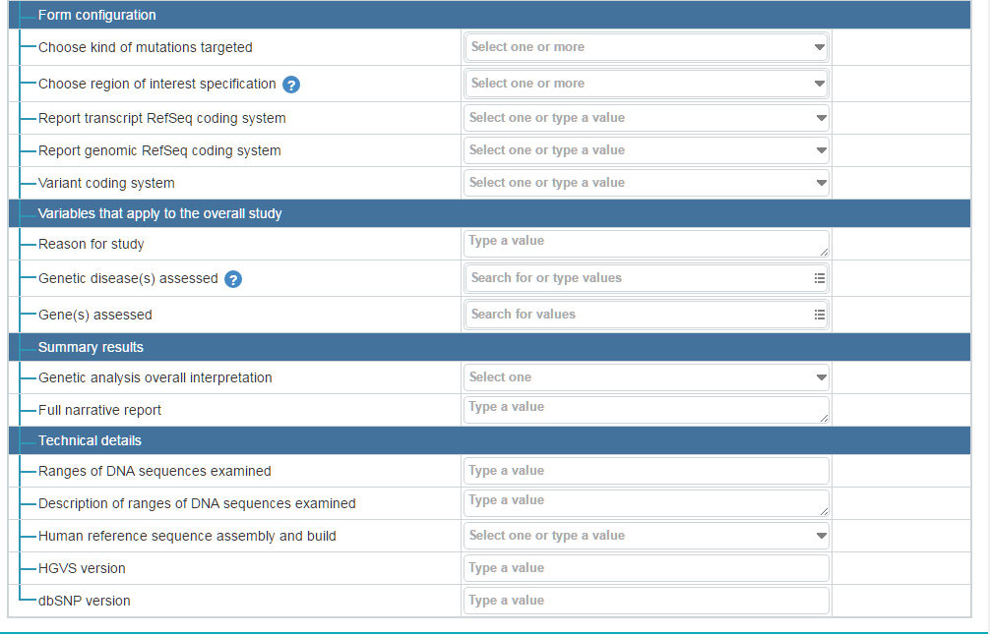
Over all report terms

Slide 14
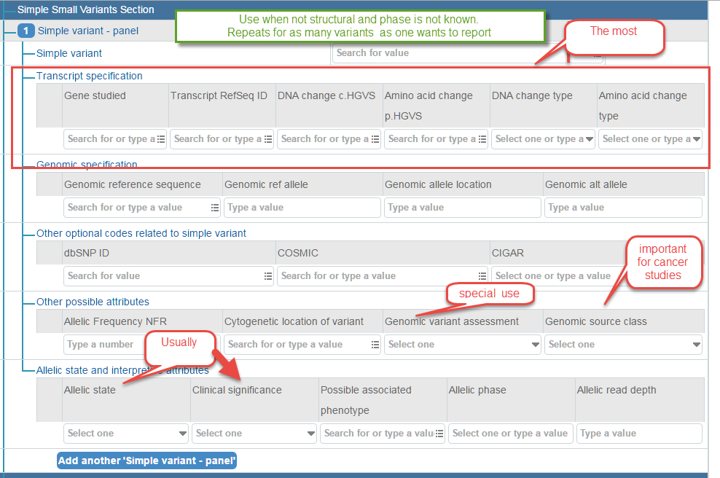
Attributes in simple variant panel

Slide 15
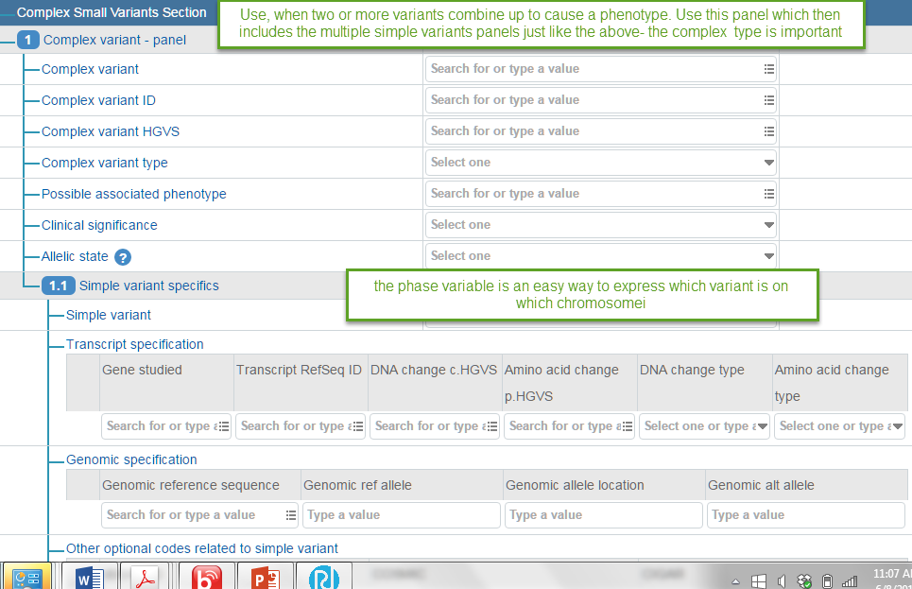
Attributes for complex variant panel

Slide 16
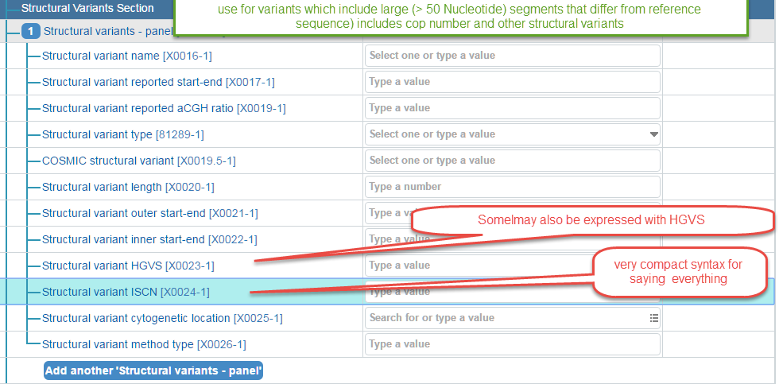
Attributes of structural variant panel

Slide 17
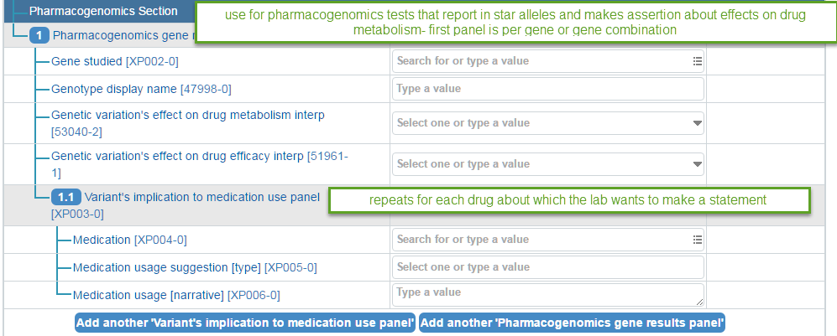
Attributes of Pharmacogenomic panels

Slide 18
Before showing live demo Brief overview on relevant NLM widgets
NLM forms is an JavaScript only opens source, very smart form generator that generates a form from all LIONC panels- We will demo the genomics panel with a live NLM Form
NLM Forms includes skip logic, nested and repeating panels, validation , autocomplete look ups and connections to external tables and variety of styles
See form demos: https://lforms-demo.nlm.nih.gov/
Also have a number of external genetic panels that tie to form
https://lforms-service.nlm.nih.gov/
Also have a UCUM units validator converter.

Slide 19
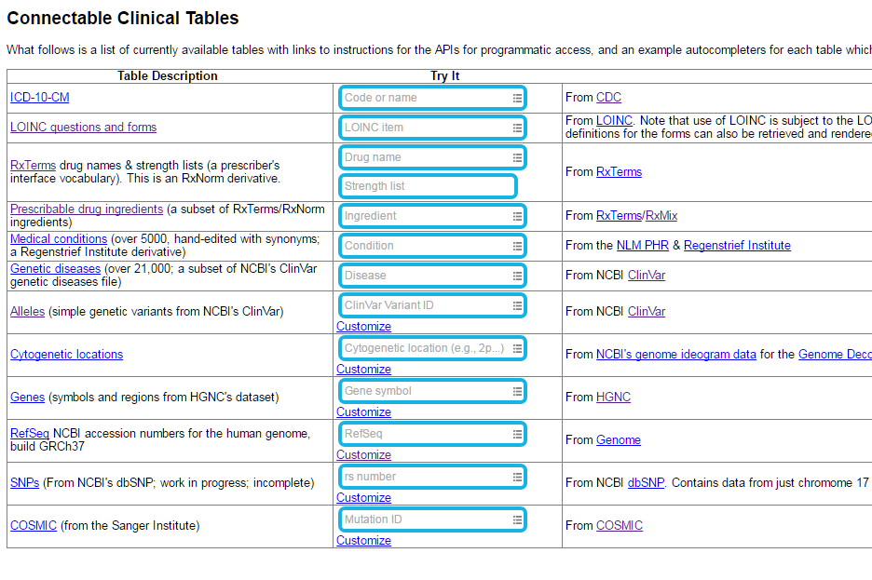
Linkable –searchable tables – so far

Slide 20
Demo of live forms with autocomplete links to genomic data base
https://lforms-demo.nlm.nih.gov

Slide 21
Show the form builder and UCUM validator bot JavaScript and to be provided Opens Source
Form Builder
url: https://lforms-formbuilder.nlm.nih.gov
For short term has a user ID and password will hand it out by voice . Under construction – so may not always be operative
URL for UCUM validator
Also under construction and not yet fully polished
http://lhncbc.github.io/ucum-lhc/

Slide 22
Details about the NLM form generator and autocomplete services 1
An overview page for the project is here:
http://lhncbc.nlm.nih.gov/project/lforms
There is demo showing LForms rendering various forms here:
https://lforms-demo.nlm.nih.gov/
LForms uses a field autocompleter package built in-house, demos for which can be seen here:
http://lhncbc.github.io/autocomplete-lhc/
The autocompleter list can come from a URL whose parameters and response meet certain requirements. We have several examples of data sources (e.g. a drug ingredient list) that can be used with the autocompleter on our “LForms-service” website, here:
https://lforms-service.nlm.nih.gov/
That page also lists the parameter and output requirements for URLs the autocompleter can use.

